Slide 1
Stacks and Queues
Lecture 6

Slide 2
Introduction
A stack and how it is implemented
A LIFO
The push (add node to stack)
pop functions (delete note from stack)
A queue and how it is implemented
A FIFO
The enqueue function (add node to queue)
Dequeue function (delete node from the queue)

Slide 3
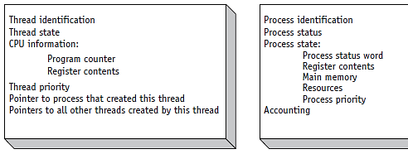
(figure 4.4)
Comparison of a typical Thread Control Block (TCB) vs. a Process Control Block (PCB). © Cengage Learning 2014

Slide 4
A call Stack
A call stack is a data structure that is used to is used to store information about the active routines (functions) in a program.
Each time a function (main or other functions are invoked they, including local variables…) are pushed onto the stack.
Once the functions is finished executing “it” is popped from the stack.
A stack operates on the last in first out principle (LIFO) (push to beginning of the stack and pop from the beginning of the stack.
This procedure is controlled by the use of a stack pointer which keeps track of the “starting” position, sometimes referred to as the head/top, of the stack.

Slide 5
12.5.3 Applications of Stacks
Stacks have many interesting applications.
For example, whenever a function call is made, the called function must know how to return to its caller, so the return address is pushed onto a stack.
If a series of function calls occurs, the successive return values are pushed onto the stack in last-in, first-out order so that each function can return to its caller.

Slide 6
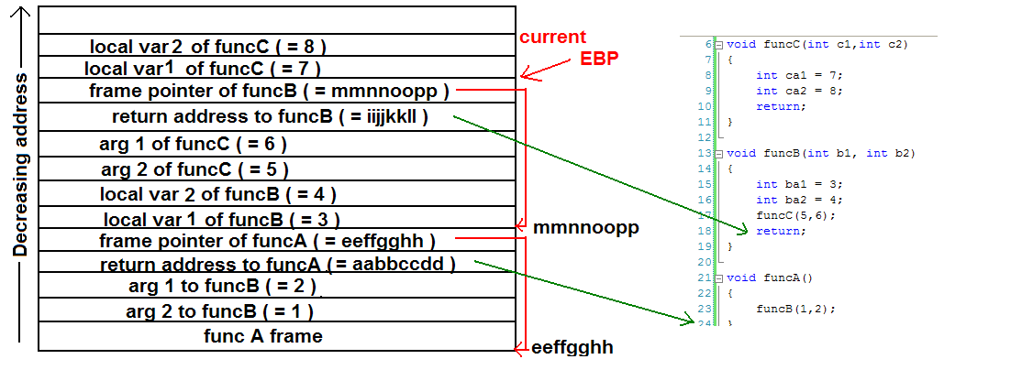
The Call stack
call stack wikipedia

Slide 7
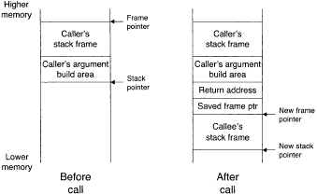
Adding (pushing) a function onto the call stack
Return to address “in code” where function called
Pointer to saved “next” frame in the stack
The frame of function “main”

Slide 8
The Stack Data Structures
A stack implemented using pointers?
Pop function off of the stack
Pointer to top of the stack : stackpointer
Function 2
Function 1
Function main
End of th stack contains a null value
Push function onto the stack
Pointer to position of previous frame address : frame pointer

Slide 9
Implementation of a Stack:
Head/Top
3
2
1
Null
A stack is a series of connected nodes
Each node contains at least
A piece of data (e.g. P.C.B or functions)
Pointer to the next node in the stack
A pointer is a variable which stores a memory address
Head (top): pointer to the first node
The last node points to NULL
Null indicates an empty stack
node
4
data
pointer

Slide 10
Create Node Sample code
Define node structure
struct stackNode {
int data; // define data as an int
struct stackNode *nextPtr; // stackNode pointer
};
typedef struct stackNode StackNode
Declare and create a node:
StackNode newPtr = malloc(sizeof(StackNode));
Assign value to StackNode fields
newPtr -> data = 4;
newPtr -> nextPtr = NULL;

Slide 11
Implementation of a stack
Two basic functions associated with stacks:
The push function: this adds a “node” to the beginning of a stack
The pop function: removes a “node” from the beginning of a non-empty stack.
Implementation is a combination of:
Creating a new node; (in C use malloc)
Assigning data to the data element of the node
Using the push function add a node to the stack
In the pop function you pop (delete) a node
The constrain that you can not pop from an empty stack.

Slide 12
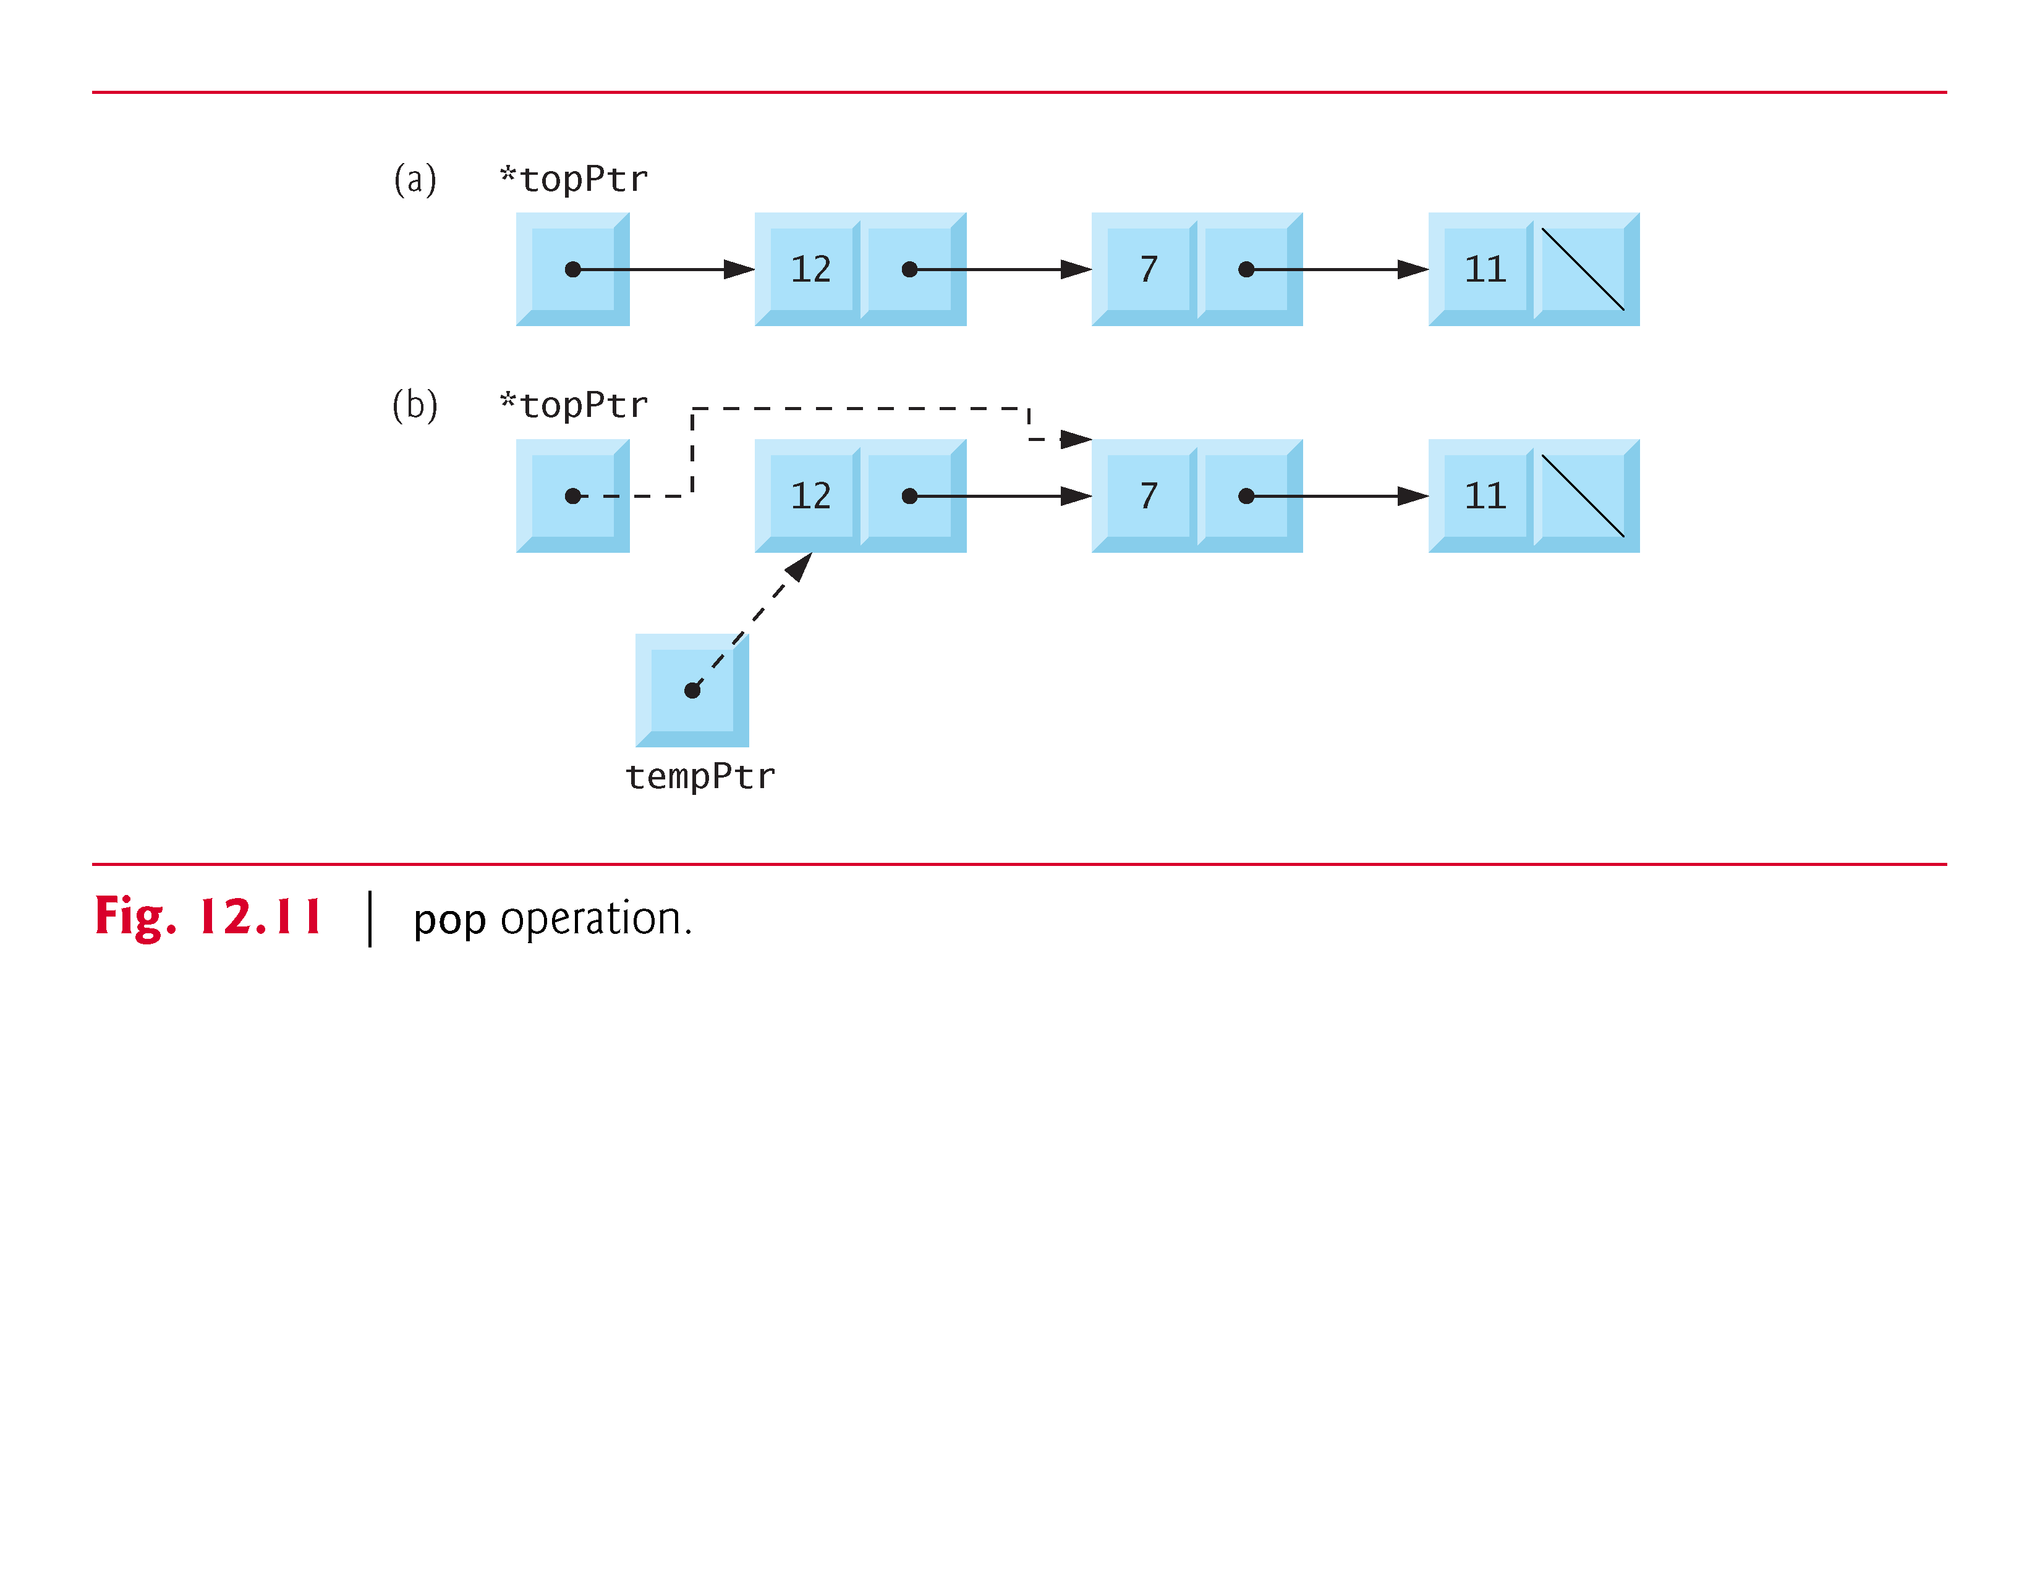

Slide 13
Delete/pop a node from the stack
The current stack containing two node
Head
&x
X
&A
null
A
Head
&x
$A
A
null
X
Assign the data element of node X to a variable data
Assign head pointer to point to second node in the stack by Assign it the value stored in the pointer element of the first node.
Return data and delete node X
Head
&A
A
null

Slide 14
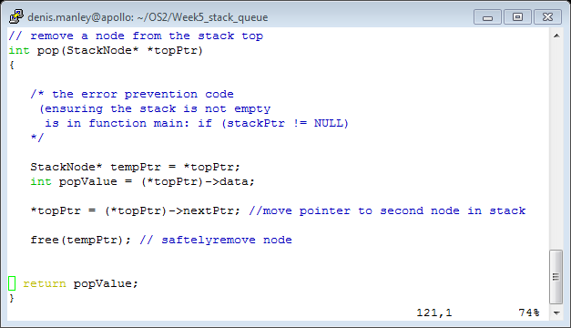
Sample code pop function

Slide 15
Function pop
Function main determines if the stack is empty before calling pop. (could also do this within the function)
The pop operation consists of five steps:
Assign *topPtr to tempPtr; tempPtr will be used to free the unneeded memory.
Assign (*topPtr)->data to popValue to save the value in the top node.
Assign (*topPtr)->nextPtr to *topPtr so *topPtr contains address of the new top node.
Free the memory pointed to by tempPtr .
Return popValue to the caller .

Slide 16
The Function push
The function consists of three steps:
Create a new node and assign the location of the allocated memory to newPtr
Assign data, that is to be added to the stack, to the new node; Assign the pointer part of the new node to point to the top of the stack. (newPtr ->nextPtr = …..
Move TopPtr to point to new node. {assign address of new node to the TopPtr}

Slide 17
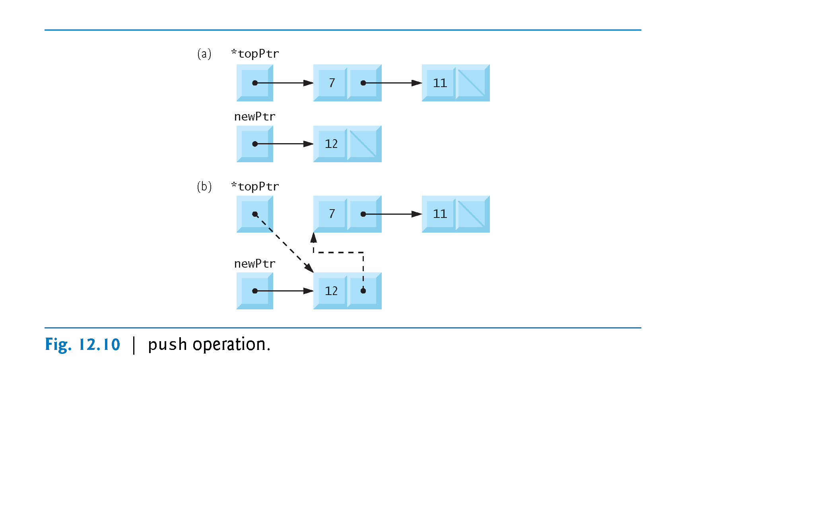
Illustration of the push function

Slide 18
Sample code push function
// refer to C how to program Deitel and Deital section 12.5 stacks
// insert a node at the stack top
void push(StackNode* *topPtr, int info)
{
StackNode* newPtr = malloc(sizeof(StackNode));
// insert the node at stack top
if (newPtr != NULL) {
newPtr->data = info;
// rest the pointers
new node points to top of the stack?
pointer to top of stack points to the new node?
}
else { // no space available
printf("%d not inserted. No memory available.\n", info);
}
}

Slide 19
Queue: Data Structures
What is a queue?
head of queue
tail of queue
A queue is used in many places in operating systems: e.g. process, virtual memory, input/output operations
It’s a structure that conforms to the principle of First In, First Out (FIFO).
The first item to join the queue is the first item to be served.

Slide 20
The queue
The queue, like the link list and stack, is comprised of nodes.
It uses two functions which, by convention, are referred to as:
enqueue (add node to end of queue)
dequeue (remove node from head of queue)
It has the constraint of not removing a node from an empty queue.

Slide 21
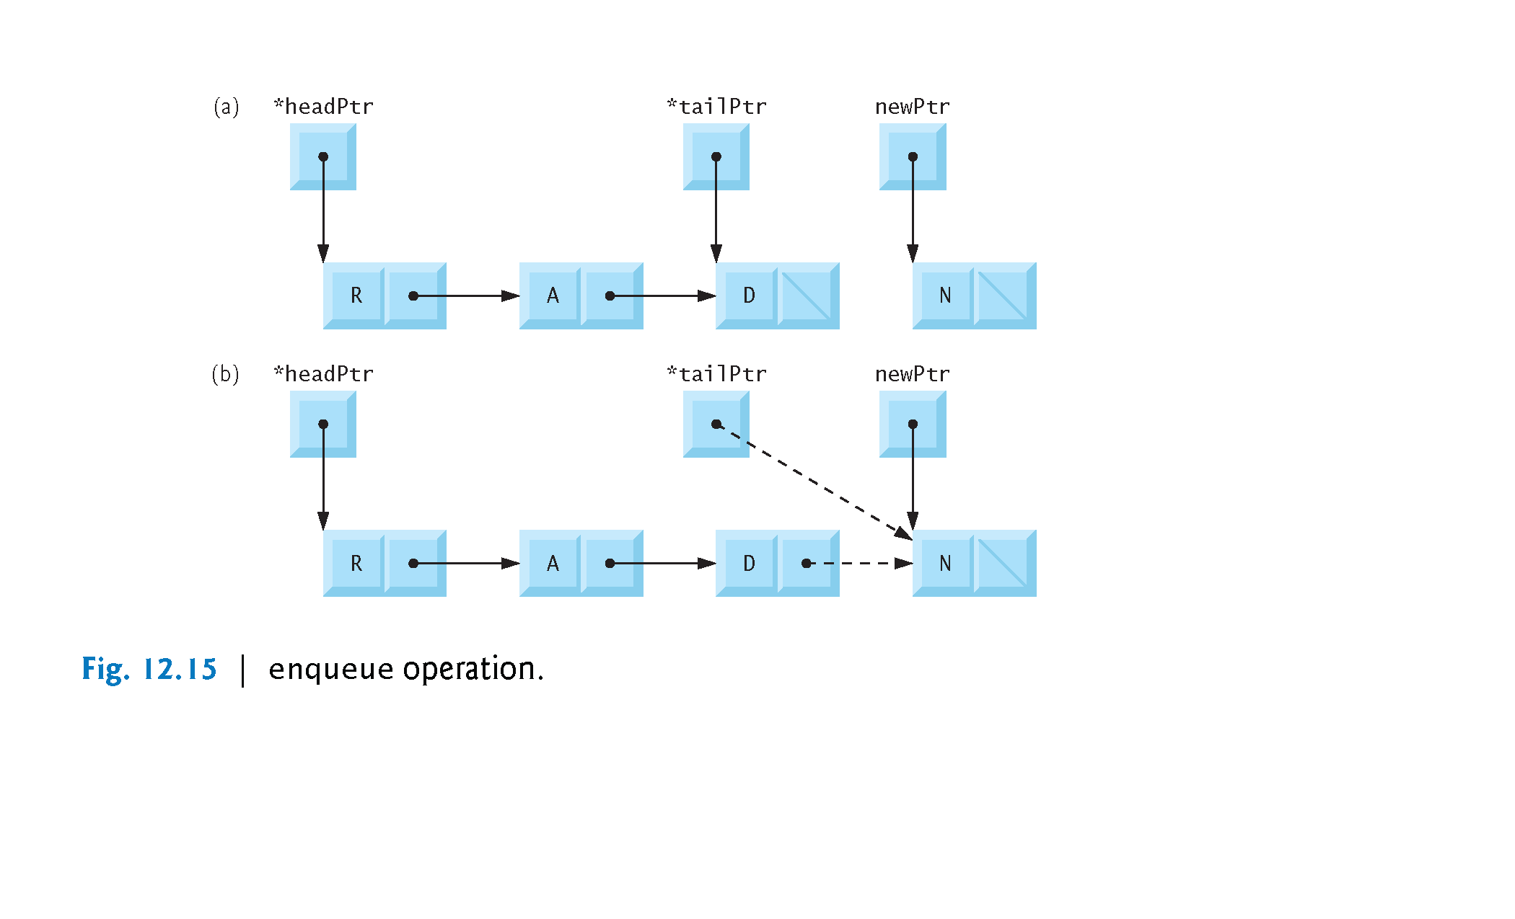

Slide 22
12.6 Queues (Cont.)
The enqueue function consists of three steps:
Create a new node:
assign data to new node;
assign null to the pointer field
If the queue is empty:
the new node will be both the head and tail of the queue; so assign newPtr to *headPtr,
otherwise
new node is added the end of the list; the tail (last) node points to the new node (how would you write a c statement for this)
Assign the tailptr to point to new node as the new node is the queue’s tail..

Slide 23
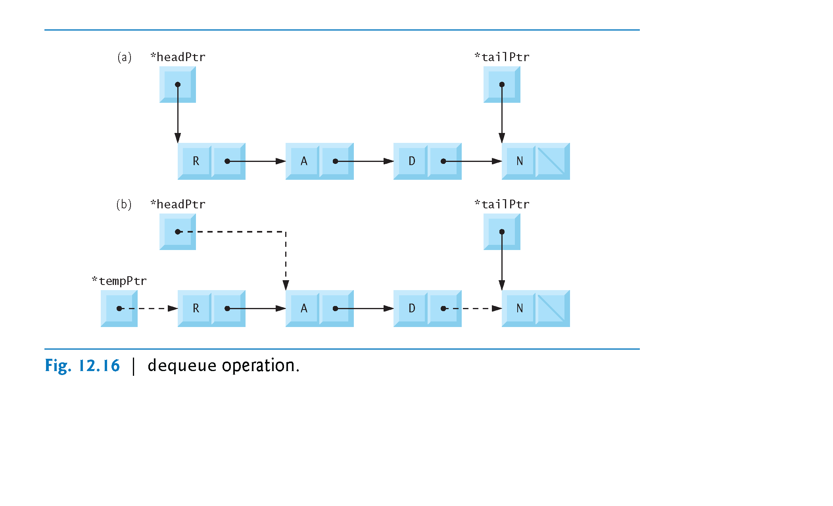

Slide 24
12.6.2 Function dequeue
The dequeue operation consists of six steps:
Ensure that there is error checking before the function is called (headptr = NULL
Assign (*headPtr)->data to value to return the value .
Assign *headPtr to tempPtr // clean up code
Assign “….” so that headPtr now points to the new first node in the queue.
If now *headPtr is NULL, assign NULL to *tailPtr because the queue is now empty.

Slide 25
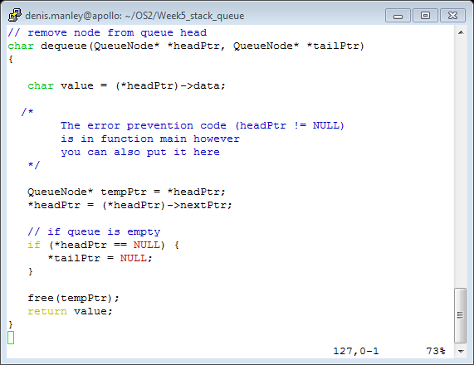
Sample dequeue code

Slide 26
Sample Questions
Describe, using an example, what is a the stack data structure and how/where it can be used in the execution of a program . (6 marks)
Describe, using examples, what is a queue data structure and give two examples of where it may used in operating systems. (6 marks)

Slide 27
Sample question
Explain, using examples (include node addresses), how to implement the enqueue and dequeue functions of a queue (15 marks)
Explain, using examples (include node addressses), how to implement the push and pop functions of a stack (15 marks)

Slide 28
Clearly explain, using an example, if this function will add a node on to the top of a stack : (you will need to explain all parts of the code) (9 marks)
//the fnt call // StackPtr is a pointer to the top of the stack data structure.
Push (&StackPtr);
void push(StackNode** topPtr, int info)
{
StackNode newPtr = malloc(sizeof(StackNode));
if (newPtr != NULL) {
newPtr->data = info;
newPtr->nextPtr = topPtr;
topPtr = newPtr;
}
else {
printf("%d not inserted. No memory available.\n", info);
}
}

Slide 29
Explain what the following code does and why if it would correctly pop a value from the stack (9 Marks)
// function to pop values from stack assuming it is not empty
int pop(StackNode** topPtr)
{
if (topPtr != Null){
StackNode* tempPtr = topPtr;
int popValue = (*topPtr)->data;
topPtr = (*topPtr)->nextPtr;
free(tempPtr);
return popValue;
}
else return ‘\0’;

Slide 30
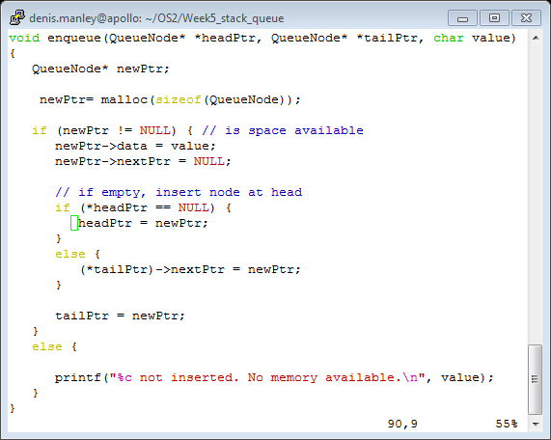
Explain if following Queue “enqueue” function will correctly add (enqueue) a node to a queue (9 marks)

Slide 31
Explain what the following code does and ìf it will successfully remove a node from the tail (end) of a queue (9 marks)
char dequeue(QueueNode** headPtr, QueueNode** tailPtr)
{
if (*headPtr != NULL){
char value = (*headPtr)->data;
QueueNode* tempPtr = headPtr;
headPtr = (*headPtr)->nextPtr;
if (*headPtr == NULL) {
tailPtr = NULL;
}
free(tempPtr);
return value;
}
Else
Printf(“bla bla bla….”);
}

